Slide 1
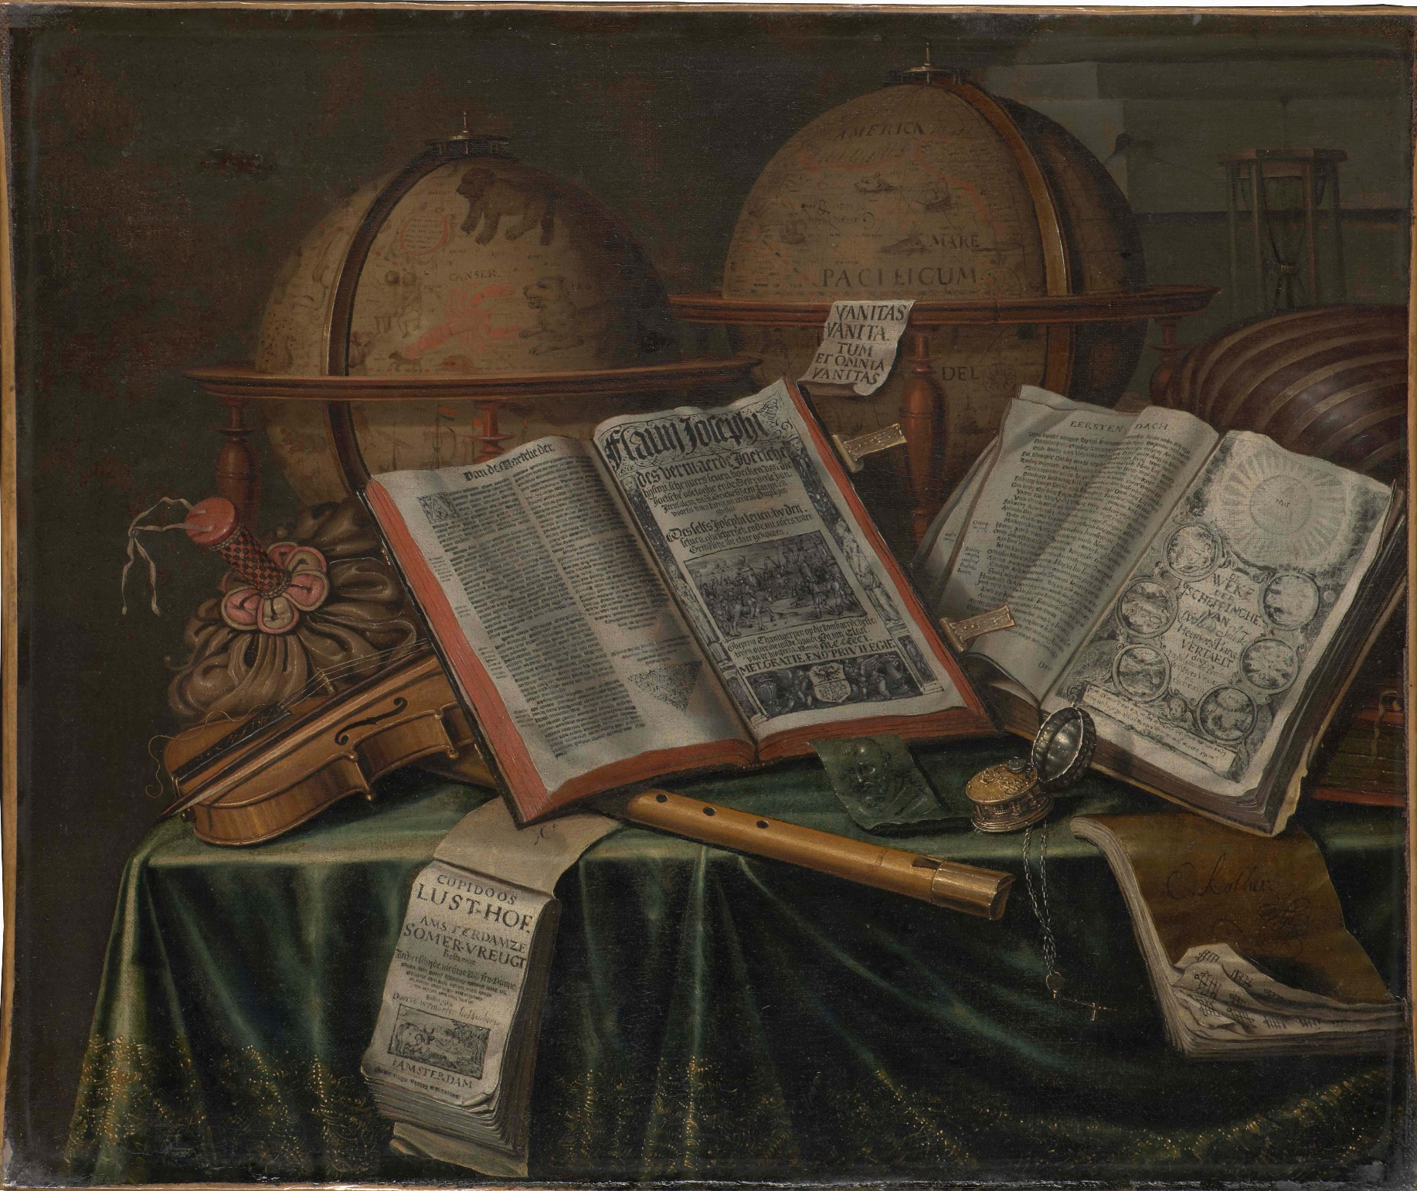
Reconstructing the book world of the seventeenth-century Dutch Republic
Andrew Pettegree and Arthur der Weduwen
University of St Andrews

Slide 2
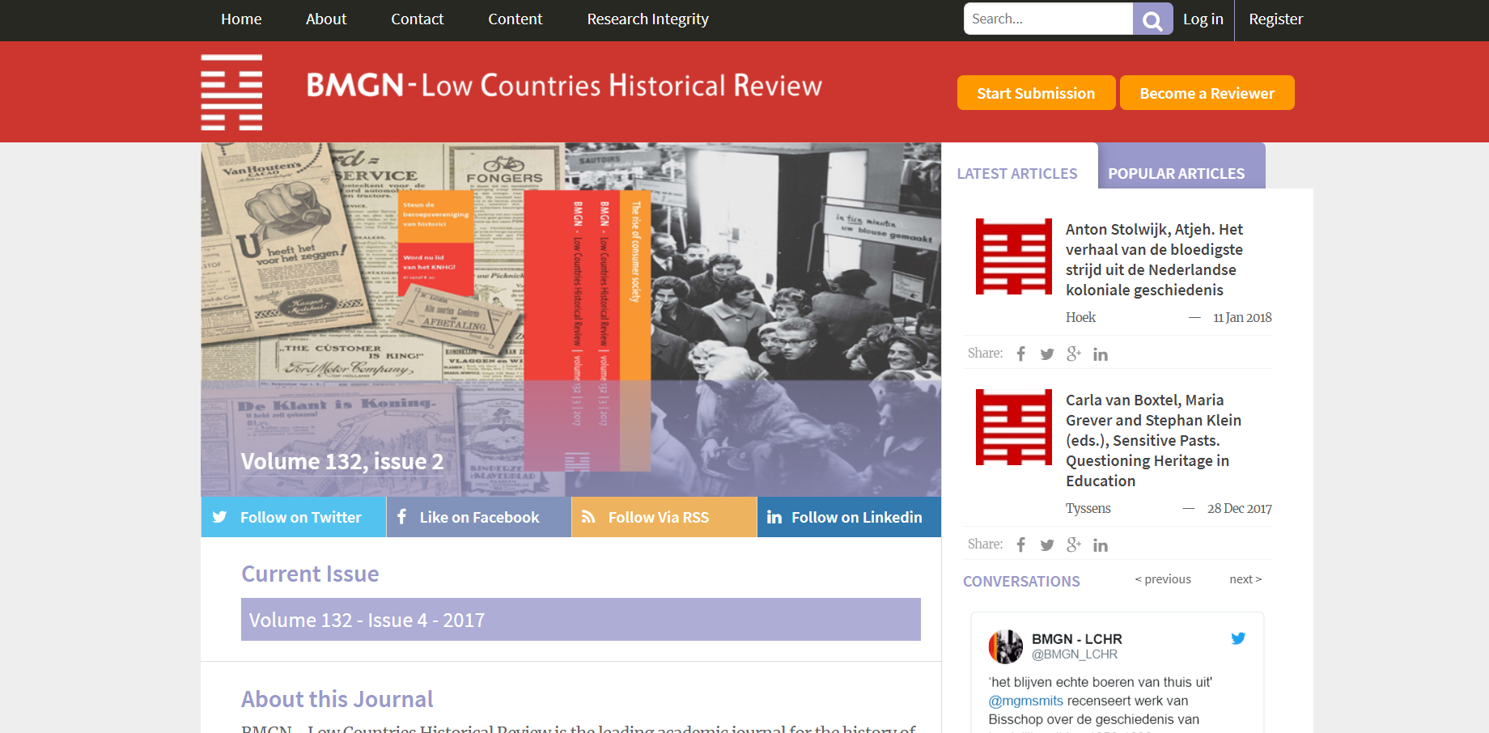
NOT ACCEPTED

Slide 3
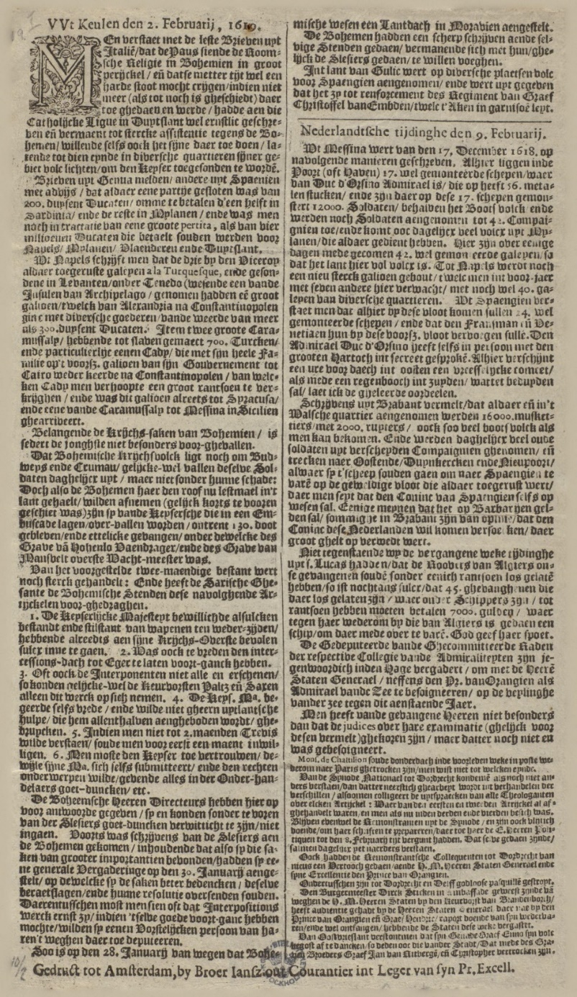
NEWSPAPERS

Slide 4
A NEW SURVEY

Slide 5
NEWSPAPER ISSUES
Newspaper publication in the seventeenth-century Dutch Republic
Dutch newspapers | 14,000
French newspapers | 7,500
Other newspapers | 1,000
Lost Dutch newspapers | 11,000
Lost French newspapers | 9,000
Total | 42,500
Newspaper publication in the seventeenth-century Dutch Republic
Dutch newspapers | 14,000
French newspapers | 7,500
Other newspapers | 1,000
Total | 22,500

Slide 6
POSTED UP AROUND TOWN

Slide 7
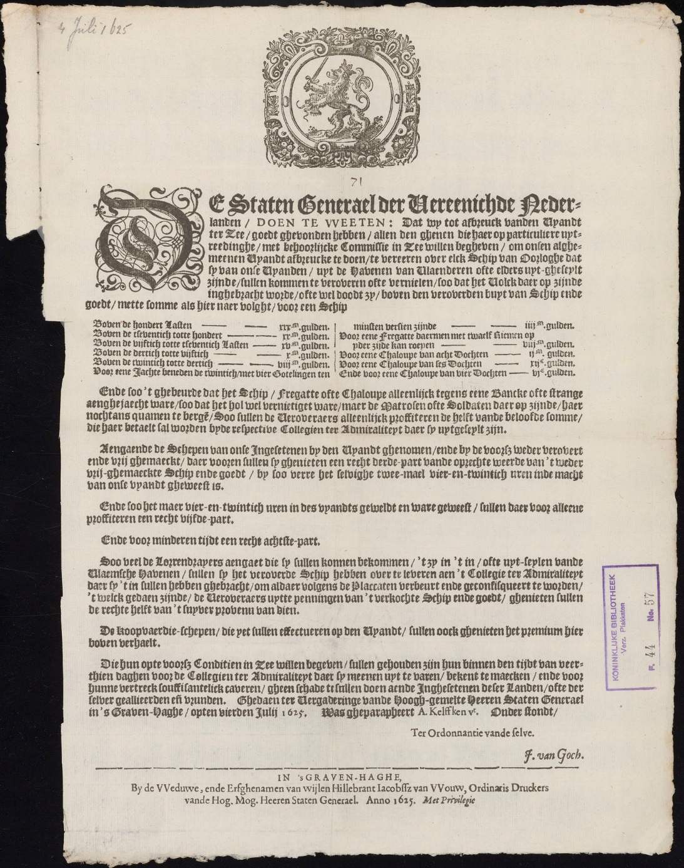
OFFICIAL PRINT

Slide 8
DUTCH JURISDICTIONS USING PRINT

Slide 9
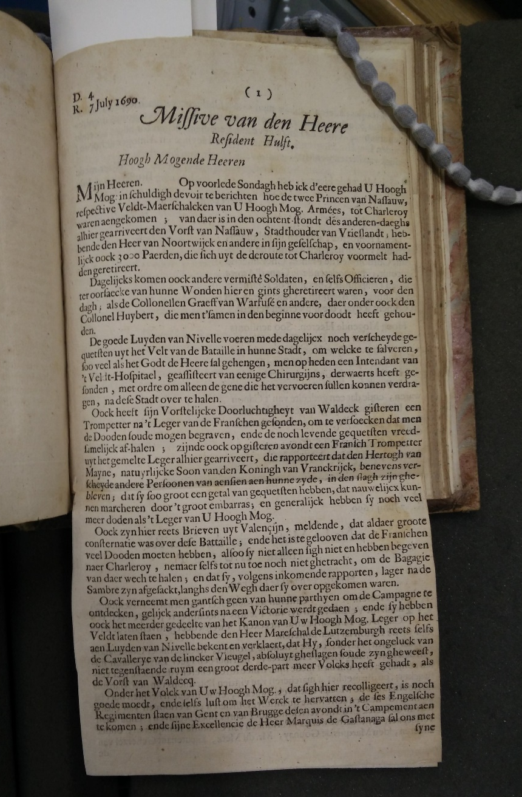
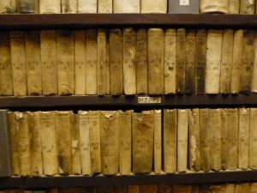
DIPLOMATIC LETTERS
DIPLOMATIC LETTERS

Slide 10
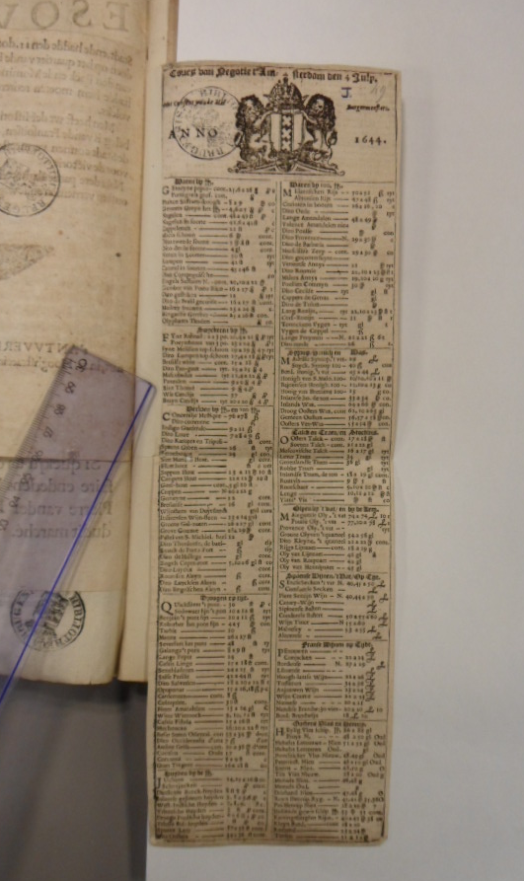
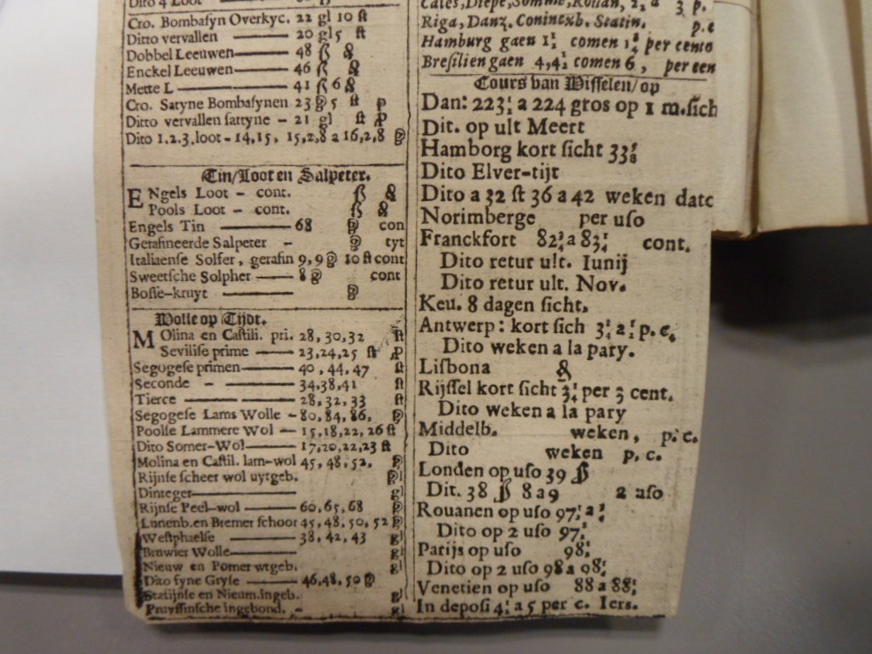
COMMODITY PRICES

Slide 11
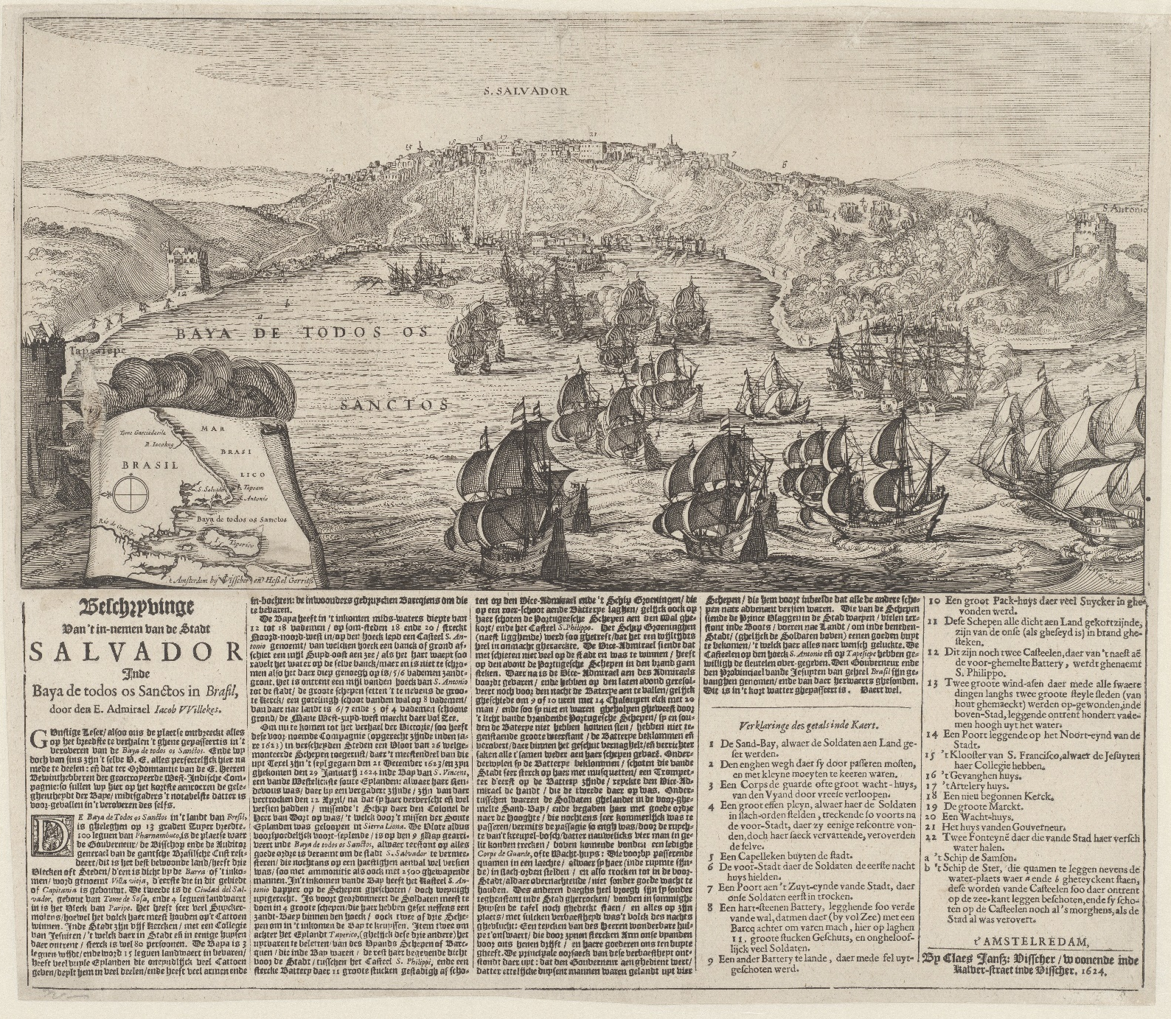
ILLUSTRATED BROADSHEETS

Slide 12
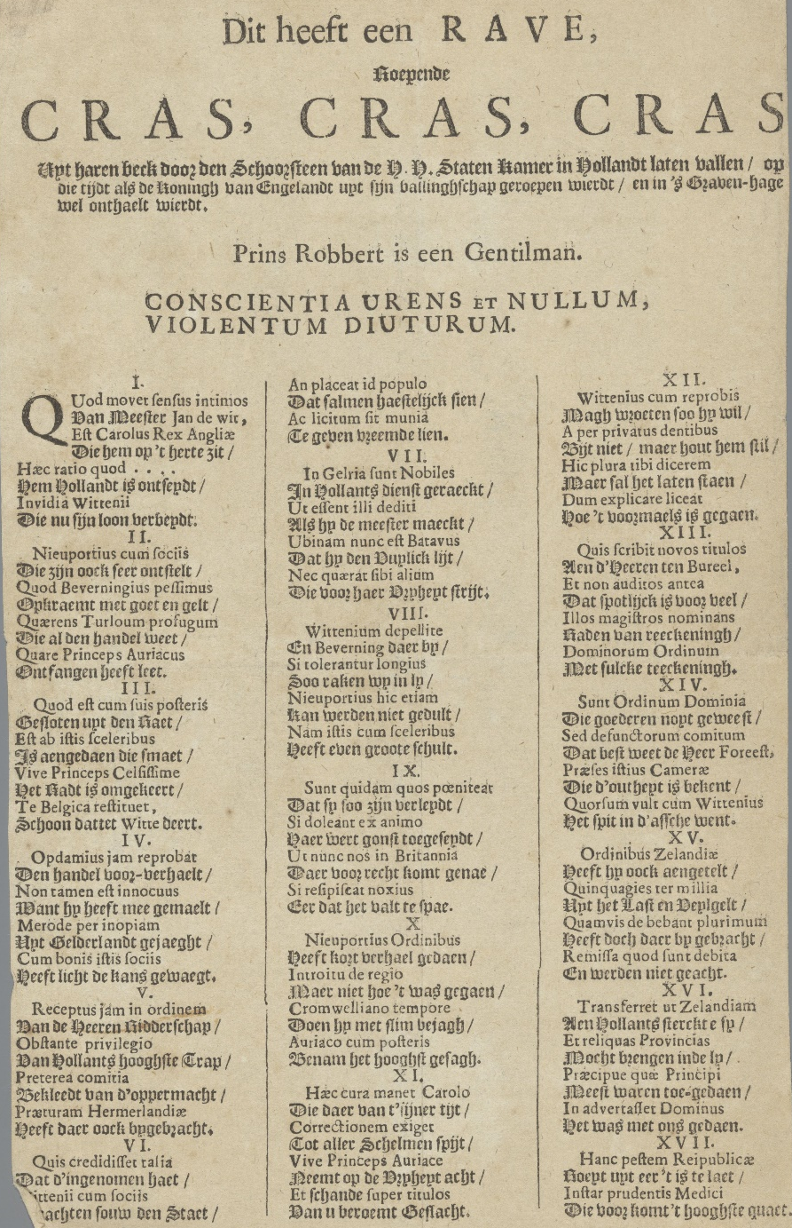
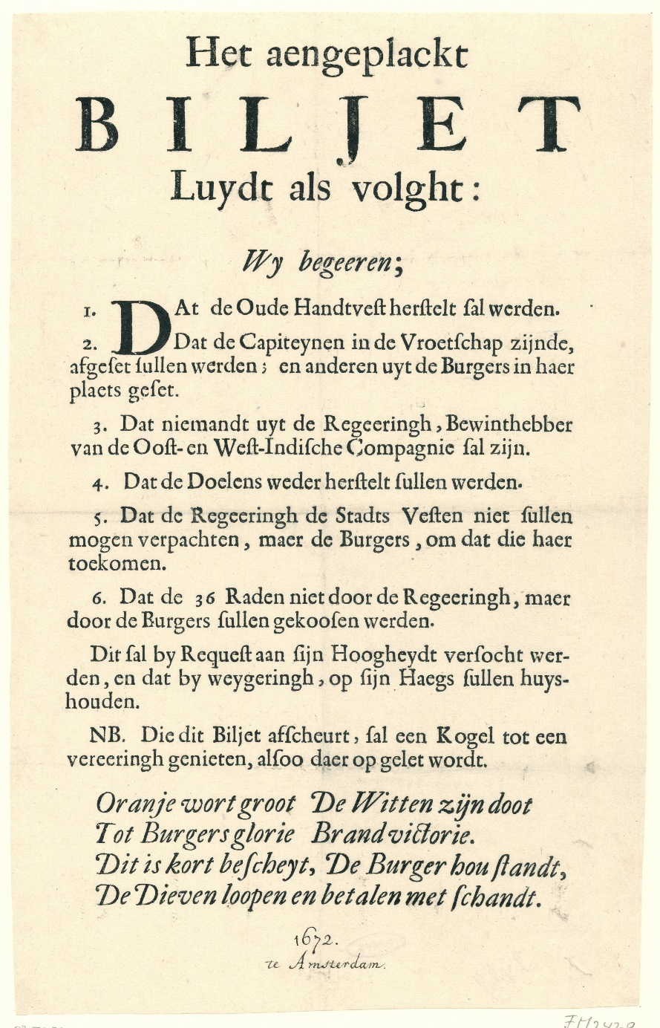
KNUTTEL BROADSHEETS

Slide 13
AUGMENTING THE STCN
The corpus of seventeenth-century Dutch print
STCN | 70,000
Newspapers | 42,500
Official print | 95,000
Printed diplomatic despatches | 18,000
Printed price and stock exchange lists | 4,000
Illustrated broadsheets | 1,500
Unillustrated broadsheets | 5,000
Totals | 166,000
New total | 236,000

Slide 14
AUGMENTING THE STCN
1. Hypothecation, underpinned by archival research
2. Searches of non-Dutch libraries
3. Contemporary printed records

Slide 15
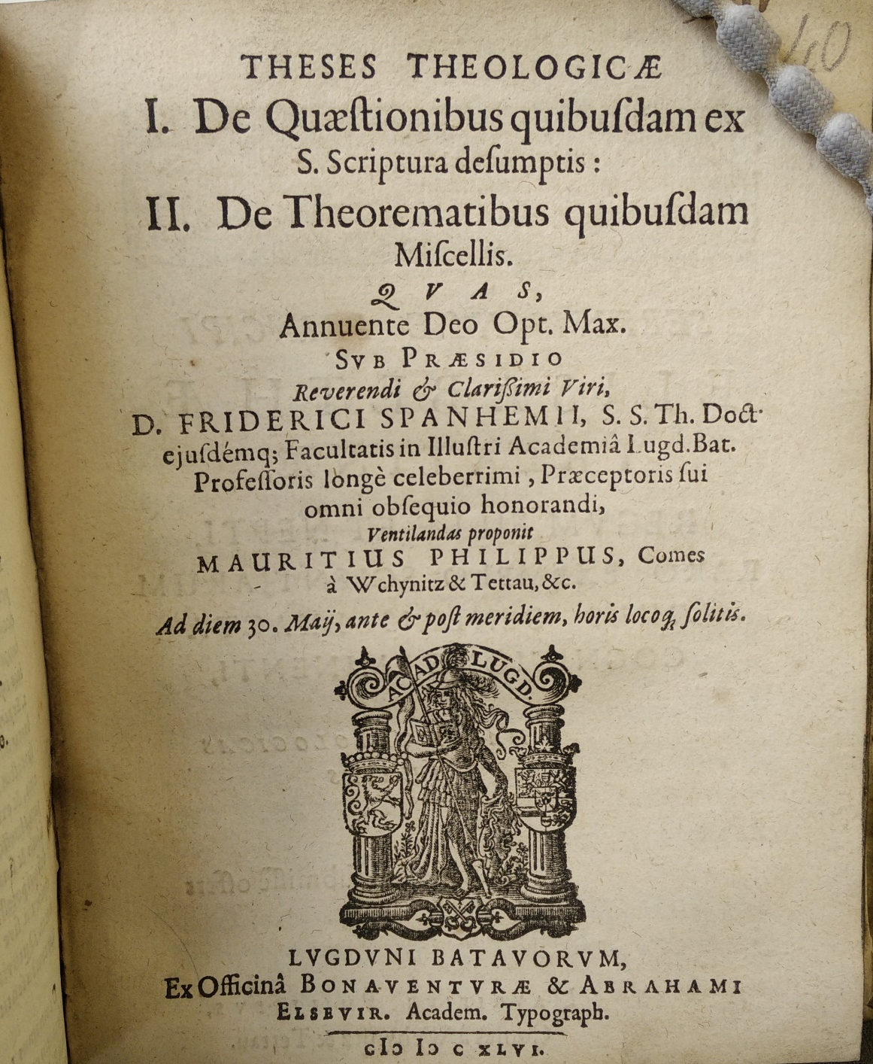
ACADEMIC DISSERTATIONS

Slide 16
ACADEMIC DISSERTATIONS
Institution | Date | 1601-1700 | 1601-1700 | 1601-1700
 |  | STCN | New | total | % increase
Leiden | 1575 | 5,106 | 412 | 5,518 | 8.1%
Franeker | 1585 | 893 | 1,785 | 2,678 | 161.0%
Groningen | 1614 | 918 | 774 | 1,692 | 84.3%
Utrecht | 1634 | 1,988 | 1,712 | 3,700 | 86.1%
Harderwjik | 1648 | 186 | 201 | 387 | 108%
Deventer | 1630 | 22 | 66 | 88 | 300%
Amsterdam | 1632 | 407 | 287 | 694 | 70.5%
Den Bosch | 1636 | 6 | 15 | 21 | 250%
Breda | 1646 | 8 | 14 | 22 | 175%
Nijmegen | 1655 | 8 | 30 | 38 | 375%
Total

Slide 17
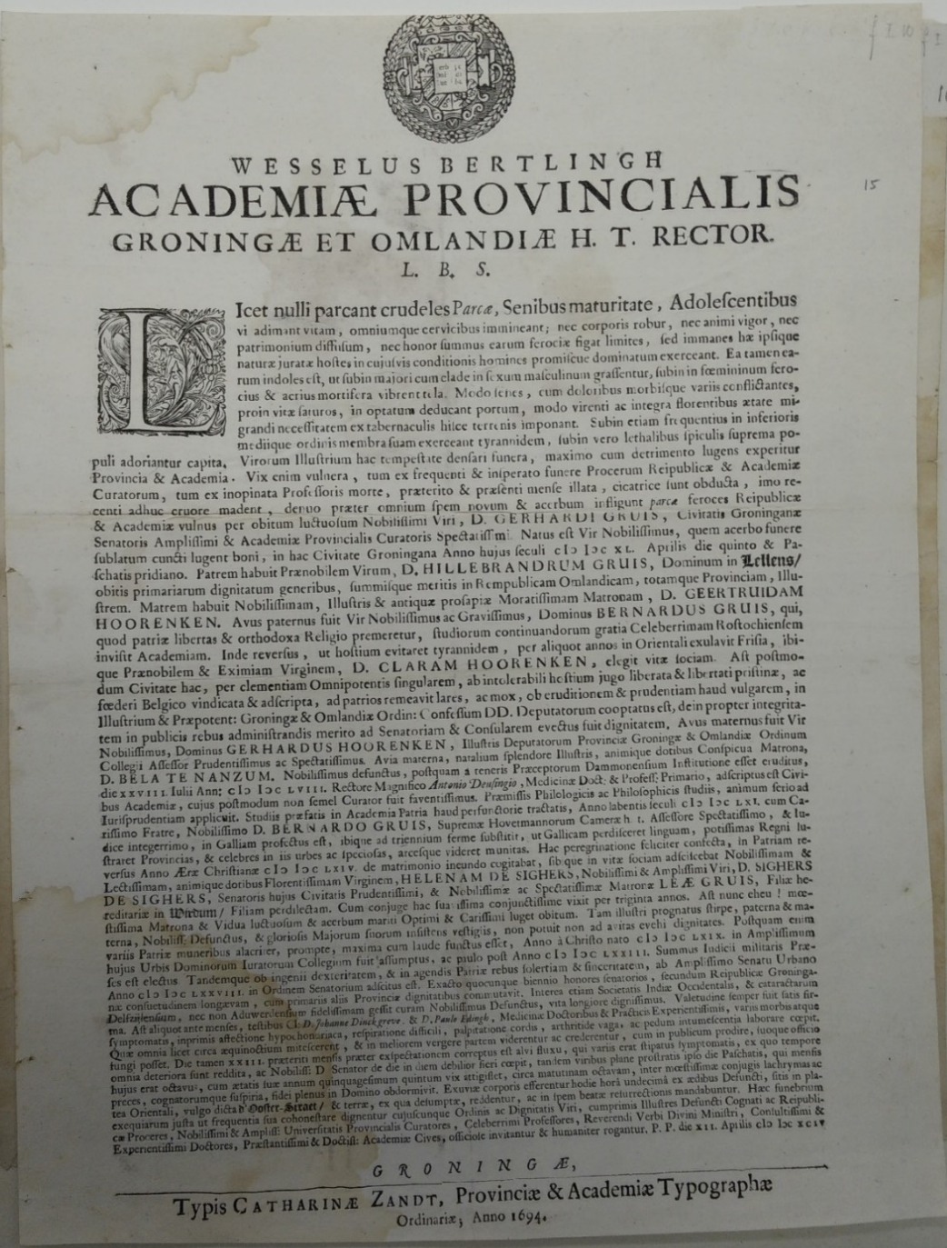
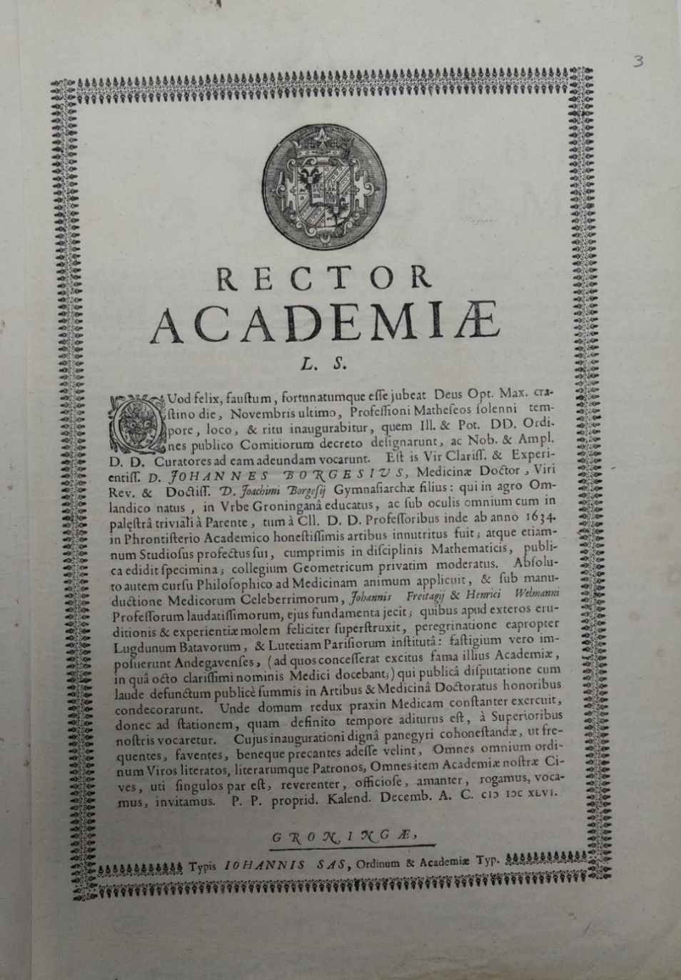
ACADEMIC EPHEMERA

Slide 18
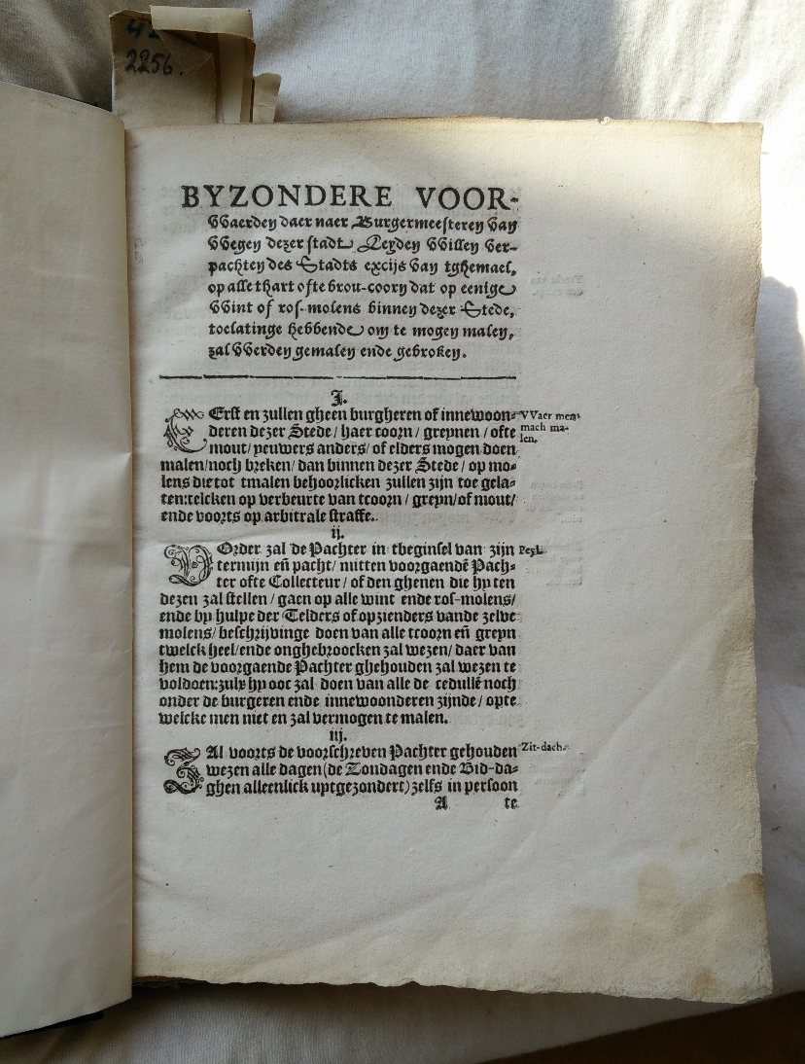
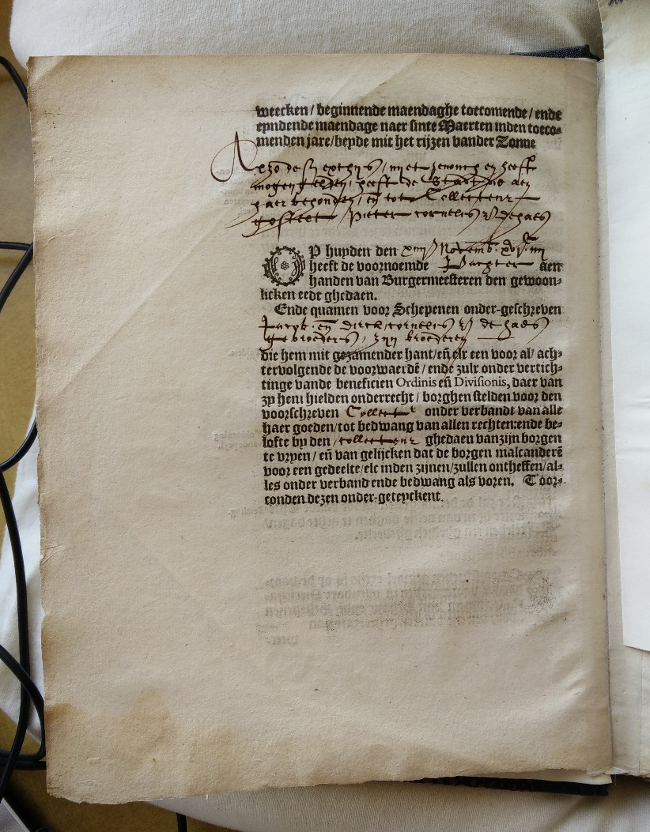
TAX FORMS

Slide 19
DUTCH BOOKS OUTSIDE THE NETHERLANDS
Date range | STCN | Non-Dutch libraries | Total
1601-1650 | 24,357 | 7,513 | 31,870 (31% increase)
Non-Dutch library searches include prominent libraries in France, Italy, Spain, Germany, Britain, Belgium and the USA not included in the STCN – but it is by no means yet an exhaustive search
Nijmegen | STCN - Nijmegen | New - Nijmegen | Total - Nijmegen
1651-1700 | 102 | 262 | 368 (389% increase)

Slide 20
NEWSPAPER ADVERTISING

Slide 21
MARTEN JANSZ BRANDT
Courante uyt Italien, Duytslandt, &c., no. 39, 26 September 1643:
D. Roelof Pietersz, Het Lof Jesu Christi onses Heeren, already published in 1643;
Item, Het Lof der kercke Jesu Christi, already published in 1643;
Item, ‘t Lof des Woordts Godts, ofte der H. Schrifture, already published in 1640;
Item, Scherm ende schilt der kinderen Godes, an explanation of psalm 91;
Item, De Spiegel der Barmhertigheyt en Gerechtigheyt Hods, in het vergeven en straffen der sonden;
Item, De Enge poorte, ofte de Wegh der Saligheyt;
Item, Korte gulden regulen eenes heyligen levens;
Item, Den Evangelischen Arendt (all enlarged and reviewed, and improved according to the new translation of the Bible) (all Amsterdam, Marten Jansz Brandt)

Slide 22
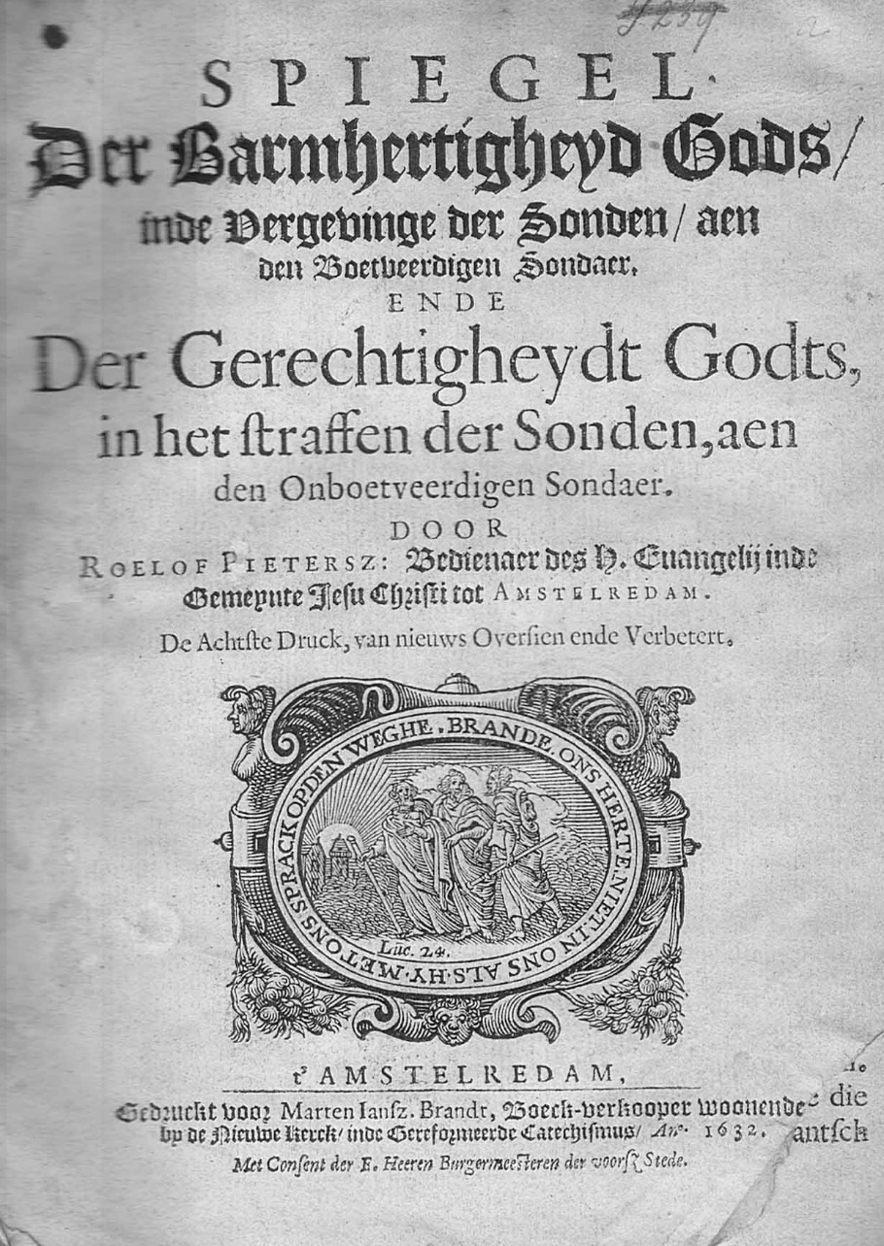
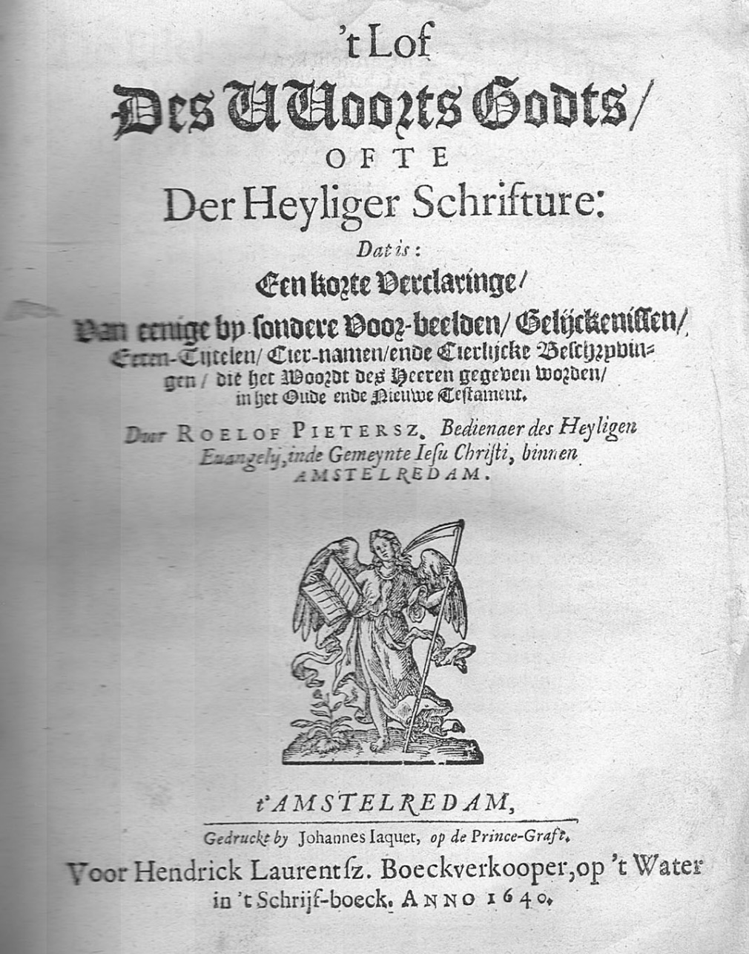
MARTEN JANSZ BRANDT

Slide 23
NEWSPAPER ADVERTISEMENTS, 1621-1650
Books advertised | Matched to STCN | Matched to other surviving editions | Lost books
1,230 | 715 (58%) | 85 (7%) | 430 (35%)
Languages
Dutch | 997 (81%)
Latin | 165 (13%)
French | 34 (3%)
Other or Multi | 34 (3%)
Formats
2o | 88 (7%)
4o | 317 (26%)
8o | 265 (22%)
12o/16o | 263 (11%)
Broadsheet | 86 (7%)

Slide 24
BOOK TRADE CATALOGUES

Slide 25
PUBLISHERS’ STOCK (JANSSONIUS 1665)
Good descriptions

Slide 26
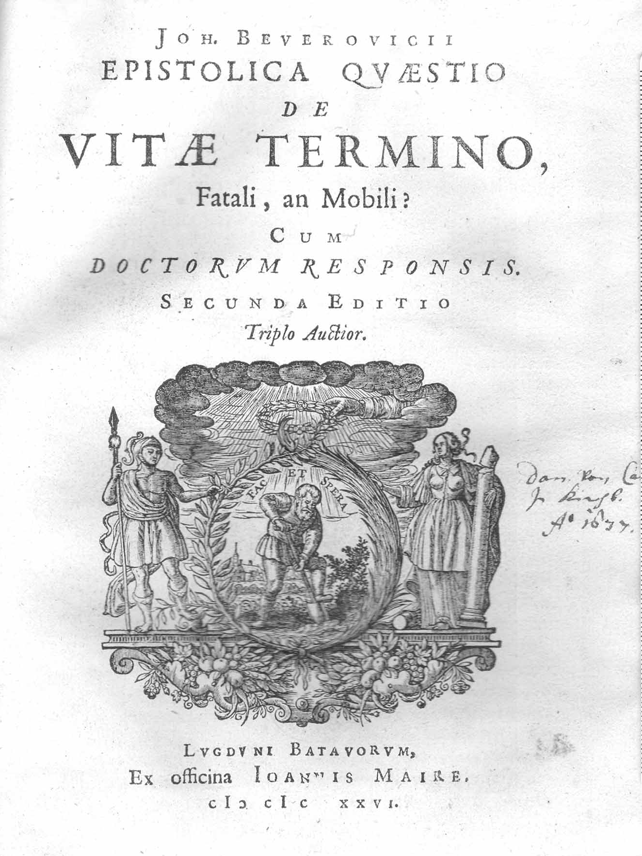
BOOK PROFILING (Beverwijck, Vitae Termino)
Johan van Beverwijck, de Vitae Termino (Leiden: Maire, 1636, 4o, 2nd edition)
Year | Owner | Profession | Place | Price
1649 | Hendrick Laurensz | Bookseller (auction) | Amsterdam
1649 | Rudolph Schuringh | Statesman | Groningen
1656 | Daniel Heinsius | Professor | Leiden | 1-11
1666 | Mattheus Spranger | Lawyer | Amsterdam
1667 | Reinhold Curicke | Statesman | Danzig
1668 | Gerard van Midlum | Doctor | Amsterdam
1674 | Daniel Elzevier | Bookseller (stock) | Amsterdam
1675 | Copenhagen library | University library | Copenhagen
1676 | Cornelis Hackius | Bookseller (auction) | Leiden
1678 | Johannis Wandalini | Professor | Copenhagen
1679 | Johannis Nansen | Bookseller (auction) | Copenhagen
1679 | Georg Witzlebii | Minister | Copenhagen
1691 | Pieter vander Aa | Bookseller (auction) | Leiden
1691 | Thomas Bartholin Jr | Professor | Copenhagen
1692 | Reinoldus Alberda | Statesman | Groningen
1692 | Reinoldus Alberda | Statesman | Groningen
1693 | Johannis Lassenii | Professor | Copenhagen
1698 | Henricus de Groot | Lawyer | Maastricht
1698 | Cornelis Nicolai | Patrician | Amsterdam | 1-12
1701 | Constantijn Huygens Jr | Statesman | The Hague | 0-8

Slide 27
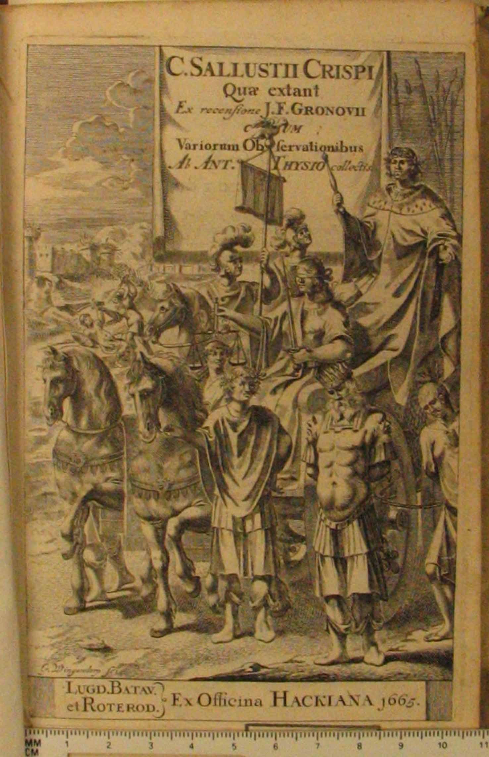
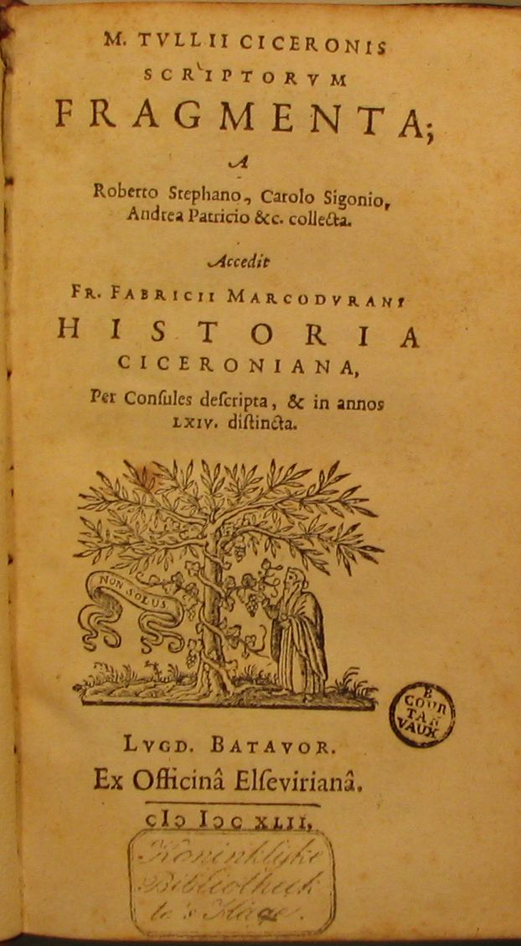
POPULAR ROMAN CLASSICS

Slide 28
VALERIUS MAXIMUS, 1585-1700
VALERIUS MAXIMUS IN THE DUTCH REPUBLIC, 1585-1649
1585 | 8o | Leiden | Plantin
1591 | 8o | Leiden | Raphelengius
1594 | 8o | Leiden | Raphelengius
1596 | 24o | Leiden | Raphelengius
1614 | 8o | Rotterdam | Berewout
1625 | 24o | Amsterdam | Blaeu
1626 | 24o | Amsterdam | Janssonius
1632 | 24o | Amsterdam | Janssonius
1639 | 24o | Amsterdam | Janssonius
1640 | 12o | Leiden | Hegerus
1647 | 12o | Amsterdam | Janssonius
1647 | 12o | Amsterdam | Janssonius
VALERIUS MAXIMUS IN THE DUTCH REPUBLIC, 1650-1700
1650 | 24o | Amsterdam | Elzevier
1650 | 24o | Amsterdam | Elzevier
1651 | 24o | Amsterdam | Janssonius
1651 | 8o | Leiden | Hackius
1655 | 8o | Leiden | Hackius
1660 | 8o | Leiden | Hackius
1660 | 12o | Amsterdam | Janssonius
1662 | 12o | Rotterdam | Leers
1670 | 8o | Leiden | Hackius
1671 | 24o | Amsterdam | Elzevier
1671 | 24o | Amsterdam | Elzevier
1671 | 12o | Rotterdam | Leers
1681 | 12o | Rotterdam | Leers
1690 | 24o | Amsterdam

Slide 29
VALERIUS MAXIMUS, 1585-1700
VALERIUS MAXIMUS IN THE DUTCH REPUBLIC, 1585-1649
1585 | 8o | Leiden | Plantin
1591 | 8o | Leiden | Raphelengius
1594 | 8o | Leiden | Raphelengius
1596 | 24o | Leiden | Raphelengius
1599 | 8o | Leiden
1600 | 8o | Leiden
1602 | 24o | Leiden | Raphelengius
1612 | 8o | Leiden
1612 | 12o | Leiden | Raphelengius
1614 | 8o | Rotterdam | Berewout
1621 | 12o | Amsterdam
1625 | 24o | Amsterdam | Blaeu
1626 | 24o | Amsterdam | Janssonius
1626 | 4o | Haarlem
1630 | 24o | Amsterdam
1632 | 24o | Amsterdam | Janssonius
1639 | 24o | Amsterdam | Janssonius
1640 | 12o | Leiden | Hegerus
1644 | 12o | Amsterdam
1647 | 12o | Amsterdam | Janssonius
1647 | 12o | Amsterdam | Janssonius
1649 | 8o | Leiden
VALERIUS MAXIMUS IN THE DUTCH REPUBLIC, 1650-1700
1650 | 24o | Amsterdam | Elzevier
1650 | 24o | Amsterdam | Elzevier
1650 | 8o | Leiden
1651 | 24o | Amsterdam | Janssonius
1651 | 8o | Leiden | Hackius
1651 | 12o | Amsterdam | Janssonius
1655 | 8o | Leiden | Hackius
1657 | 8o | Leiden | Hackius
1660 | 8o | Leiden | Hackius
1660 | 12o | Amsterdam | Janssonius
1662 | 12o | Rotterdam | Leers
1662 | 12o | Amsterdam
1670 | 8o | Leiden | Hackius
1671 | 24o | Amsterdam | Elzevier
1671 | 24o | Amsterdam | Elzevier
1671 | 12o | Rotterdam | Leers
1674 | 12o | Rotterdam
1681 | 12o | Rotterdam | Leers
1690 | 24o | Amsterdam

Slide 30
The corpus of seventeenth-century Dutch print
STCN | 70,000
Books in libraries not covered by STCN | 15,000
Newspapers | 42,500
Printed diplomatic despatches | 15,000
Official print | 95,000
Printed price and stock exchange lists | 4,000
Illustrated broadsheets | 1,500
Unillustrated broadsheets | 5,000
Academic broadsheets | 15,000
Academic dissertations | 5,000
Book trade catalogues | 3,500
Lost books | 14,000
Lost academic dissertations | 55,000
Tax forms | 18,000
Totals | 358,500

Slide 31
Lost books, 69,000
STCN, 70,000
Academic dissertations, 5,000
Other libraries, 15,000
Tax forms, 18,000
Book trade catalogues, 3,500
Newspapers, 42,500
Broadsheets, 120,500
Diplomatic despatches, 18,000

Slide 32
Longer than two sheets, 62,500
Two sheets or less, 297,000

Slide 33
Retail, 86,000
Free, 227,000
Subscription, 46,500

